Slide 1
Agricultural College and Agricultural Secondary School in Benesov
The agricultural students are preparing for Industry 4.0
ASAP

Slide 2
Agricultural students are preparing for Industry 4.0
Our project partners
City College Norwich (Easton College), Great Britain
Jordbrugets Uddannelsescenter Arhus, Denmark
Munkagårdsgymnasiet Tvååker, Sweden

Slide 3
Agricultural students are preparing for Industry 4.0
Reasons to the project realization
the fourth industrial revolution called Industry 4.0
the development of digitization, automation and robotic automation also in agriculture
the Industry 4.0 is not only new machinery but also technologies connected with climate changes, increasing number of people, precise agriculture with orientation of navigation systems, electronics and IT
we educate our students for the future

Slide 4
Agricultural students are preparing for Industry 4.0
Reasons to the project realization
it´s needed to implement new knowledge and skills to the curricula
it´s needed to improve skills and competences of students but teachers as well

Slide 5
Agricultural students are preparing for Industry 4.0
Why to do it international?
There are different conditions how to adapt to Industry 4.0 in individual countries.
Students and teachers have chance to compare real conditions for farming and implementation of new technlogies in agriculture in partners countries.
The participating students are future farmers or workers in agriculture of the EU (not only in the Czech Republic, the UK, Denmark or Sweden).

Slide 6
Agricultural students are preparing for Industry 4.0
Why to do it international?
The participants will understand the way of necessity of dividing the Europe in producing different commodities in different parts of the EU.
It´s good to share the experience with other schools abroad.

Slide 7
Agricultural students are preparing for Industry 4.0
Four Transnational Learning Activities
The Transnational Learning Activities are planning for 30 students and 6 teachers in each partner country.
The participants visit farms and have possibility to speak with farmers about challenges but also barriers for new technology implementation. The visit some research centers, machinery producers, exhibition of agricultural machinery etc also.
They visit schools involved, they compare agricultural education and conditions for practical training.

Slide 8
Agricultural students are preparing for Industry 4.0
Four Transnational Learning Activities
We want the participants to be a little bit active. During the each TLA the student teams present their schools, to well known the others with the situation in agriculture in their country or introduce a typical farm. They also make presentation, videos and take picture from each visit. They should add their point of view.
These are materials for our final report which summarized the situation in involved countries.

Slide 9
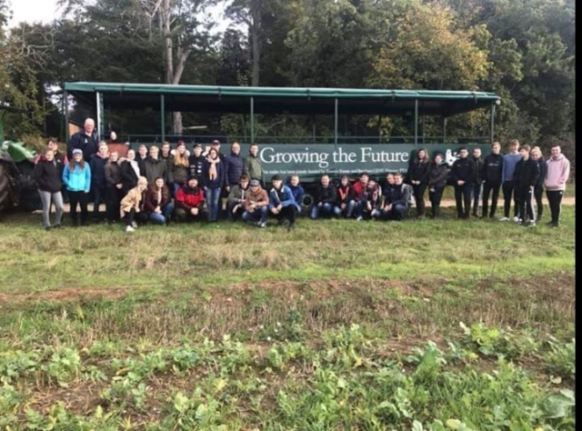
The first Transnational Learning Activity
Easton and Otley College, 21 – 25 October 2019

Slide 10
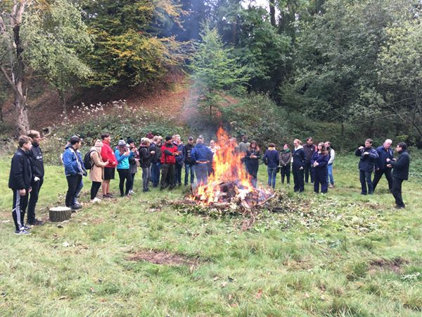
The first Transnational Learning Activity
Easton and Otley College, 21 – 25 October 2019

Slide 11
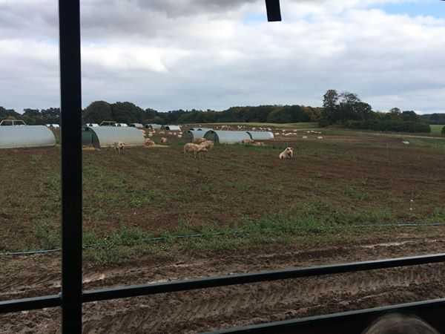
The first Transnational Learning Activity
Easton and Otley College, 21 – 25 October 2019

Slide 12
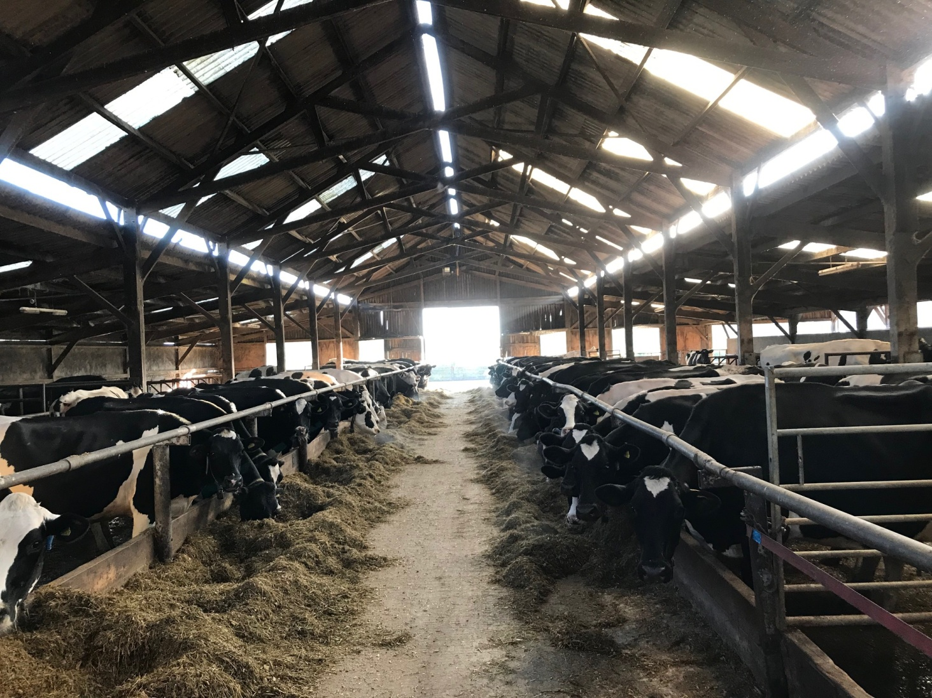
The first Transnational Learning Activity
Easton and Otley College, 21 – 25 October 2019

Slide 13
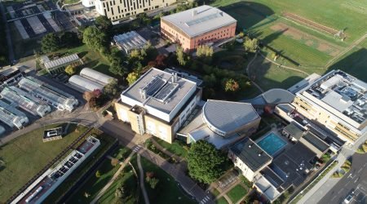
The first Transnational Learning Activity
Easton and Otley College, 21 – 25 October 2019

Slide 14
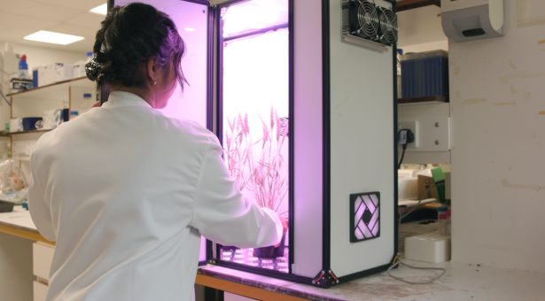
The first Transnational Learning Activity
Easton and Otley College, 21 – 25 October 2019

Slide 15
Agricultural students are preparing for Industry 4.0
What we are solving now?
We had to cancel two Transnational Learning Activities (in April 2020 in the Czech Republic and in September in Sweden)
The next Transnationanl Learning Actvitiy is planed in April 2021 in the Czech Republic.
We want to keep our project „alive“ and we are disccusing some on-line activities.
We would like to postpone the end of the project.

Slide 16
Agricultural students are preparing for Industry 4.0
Our websites and Facebook
www.asapagri.cz
https://www.facebook.com/ASAP-The-agricultural-students-are-preparing-for-Industry-40-100105068087951

